Slide 1



Slide 2

webserver
website
docker-compose.yml
Dockerfile
nginx.conf

Slide 3
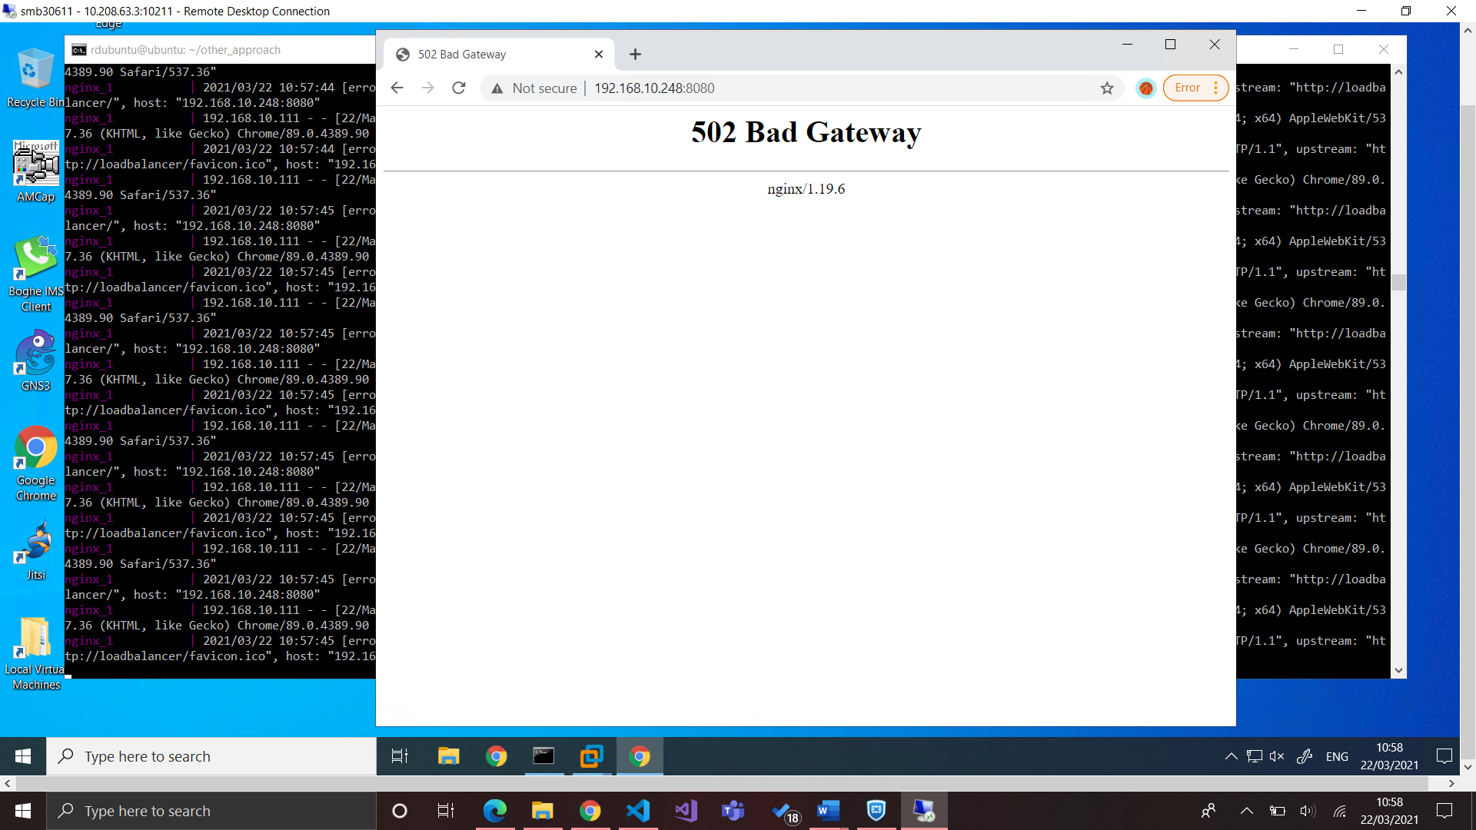

Slide 4
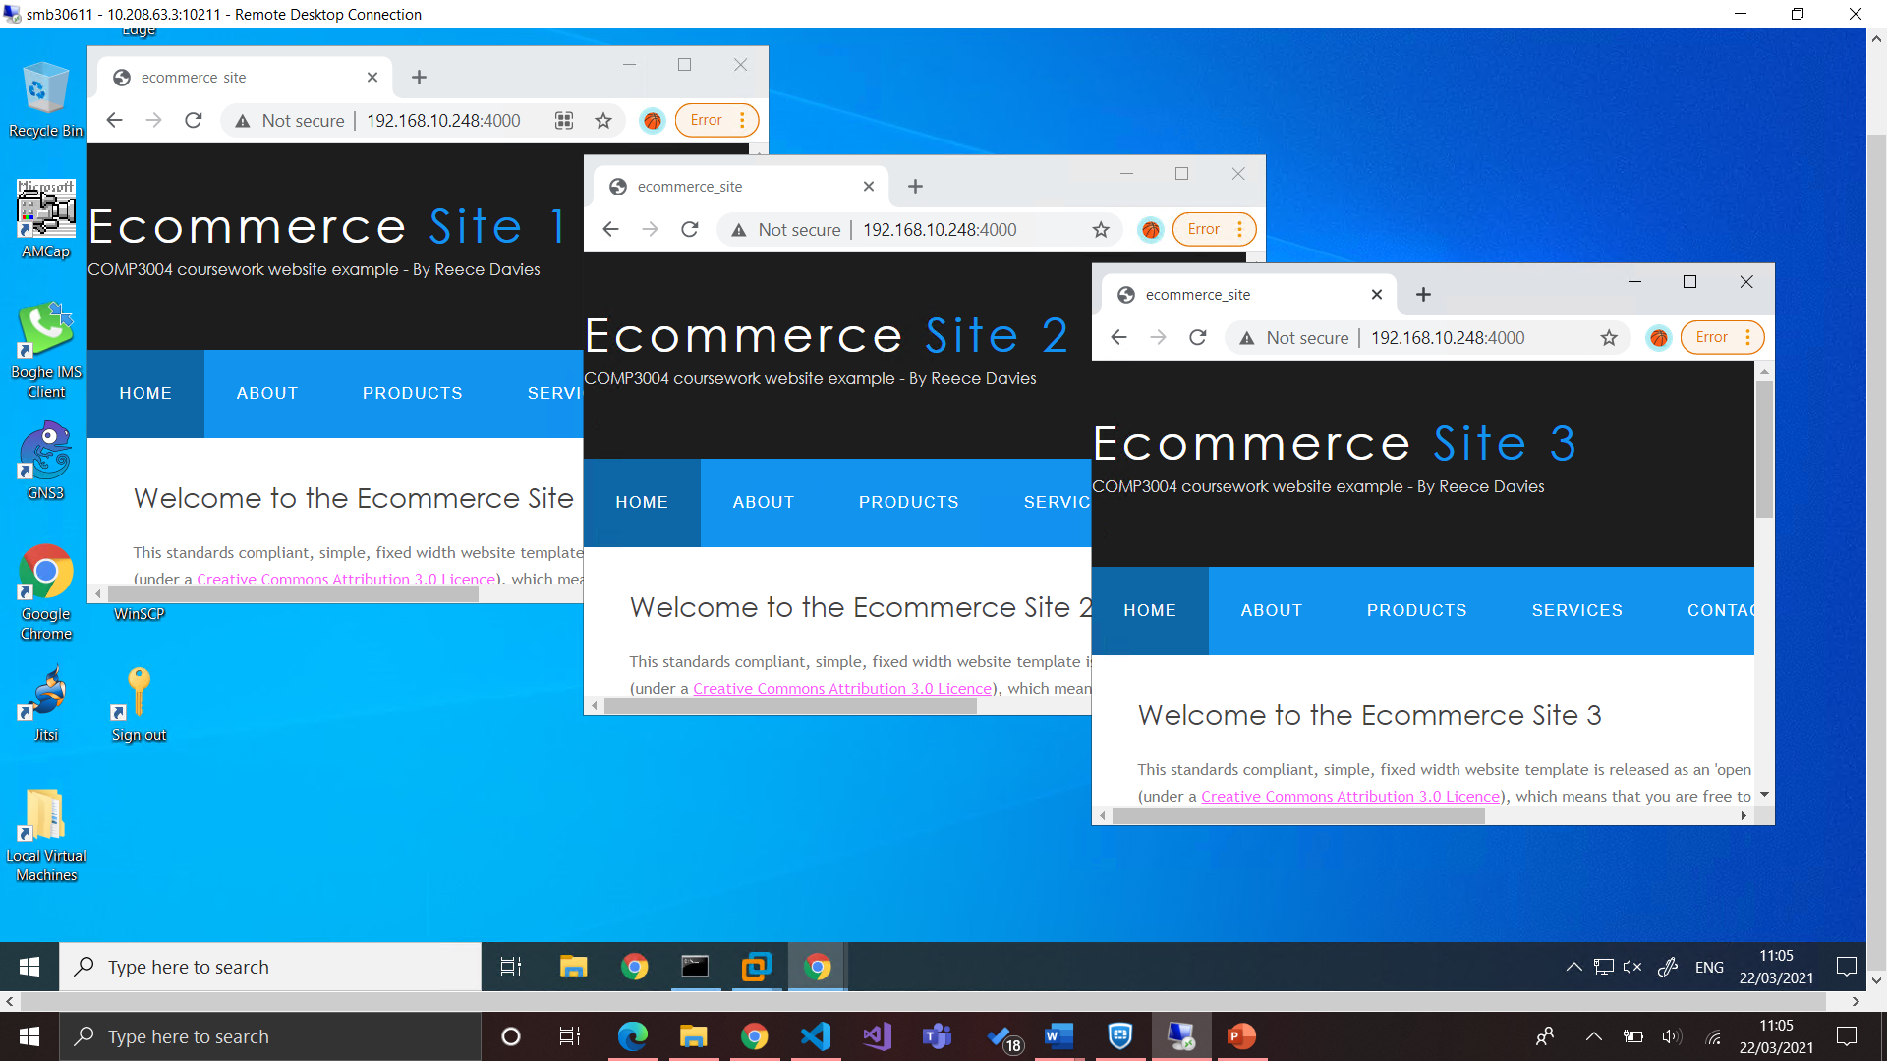

Slide 5
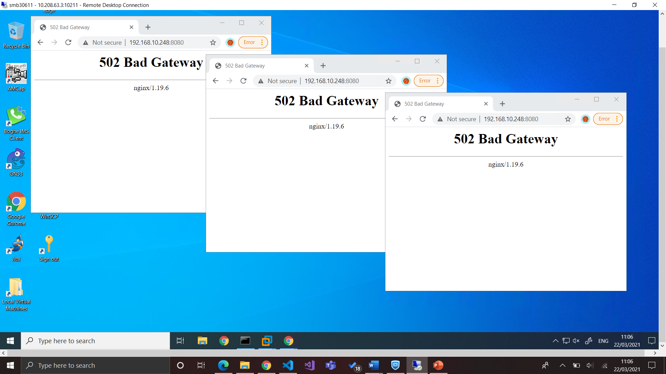

Slide 7


Slide 8
